Slide 1

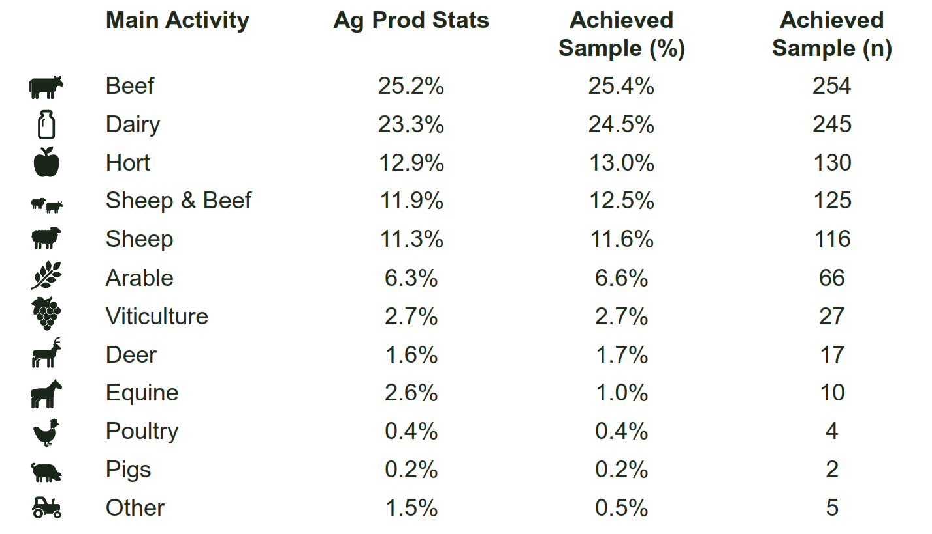
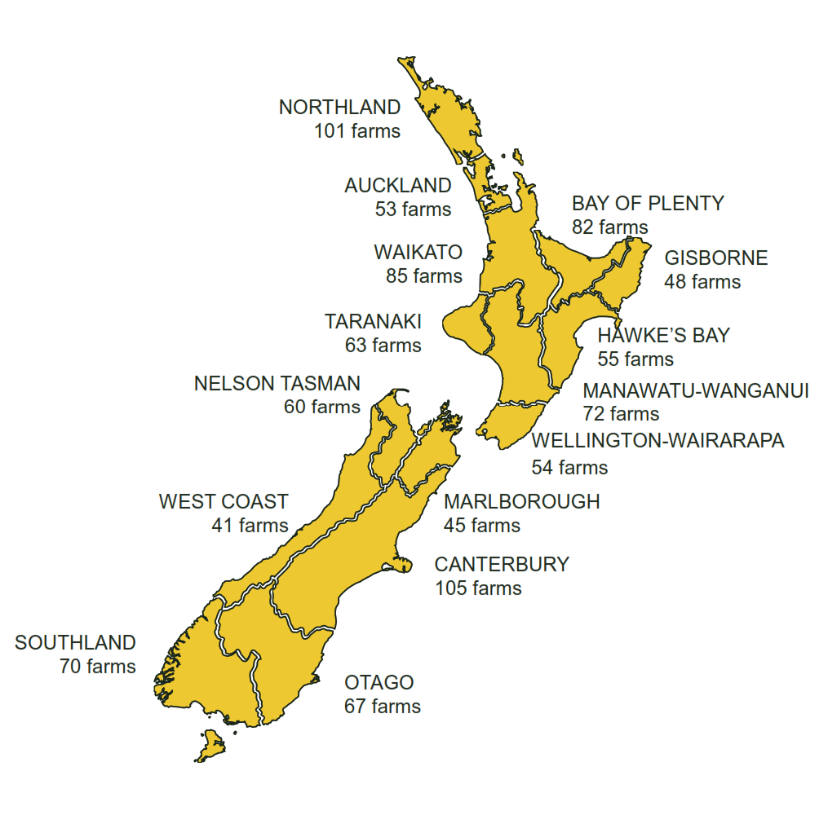






1001 farmers/growers interviewed

Slide 2
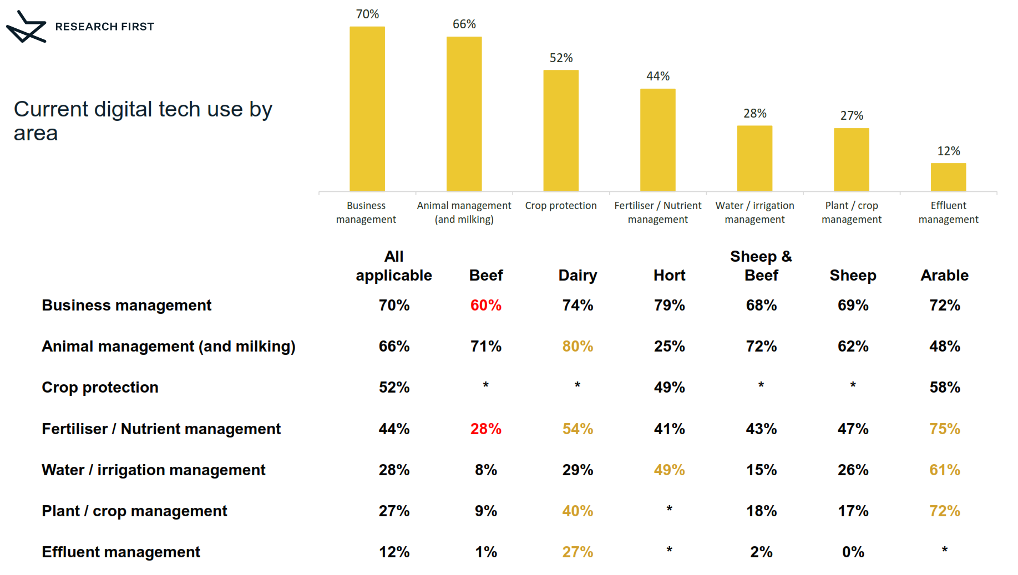
Current use of digital tools by sub-sector

Slide 3
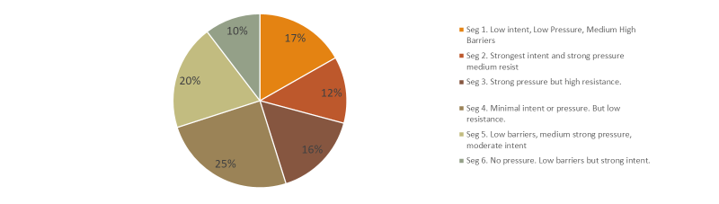
Six useful segments
Notes:
Marked differences in scores searched for
Rating of internet service on farm was not significant in any segment – it isn’t explaining the story – the issue is past its use by?

Slide 4

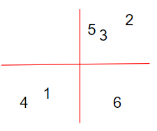
48%
Segment | Indicators | Type | Title
Segment one 17% - low intent - low pressure - medium/high barriers | Lifecycle: Decline/exiting Age: older; Ownership: single owner Northland – lower regional pressures Beef | Laggards | Consciously Conservative
Segment two 12% - strongest intent - strong pressure - medium resistence | Equity partners/ company shareholdings (400ha+) Male Younger (35-54) Canterbury –regional pressures; Sat broadband Dairy, Arable Driven by profit margins and efficiency + env. | Innovators / early adopters gain a competitive advantage or get a leg up on an emerging problem | Visionaries : Leading lights
Segment three 16% - strong pressure - high resistance | Equity partnerships / company shareholdings Older (55-64) Dairy | Early majority / followers Motivated but challenged large chasm | Pressured Pragmatists
Segment four 25% - Minimal intent - Minimal pressure - Low resistance | Single owner; Disengaged Smaller farms (up to 80ha but particularly 10-80ha) Older (65+) Beef | Laggards | Unconsciously Conservative
Segment five 20% - Low barriers - Medium/strong pressure - Moderate intent | 80-400ha Manawatu-Wanganui Most keen on data sharing, low perception of risk Early followers: | Early majority / followers large chasm Primed and ready | Poised Pragmatists
Segment six 10% - Strong intent - Low barriers - No pressure | 35-44 Can see the value of digital tech Slow adopters – let others try it first | Late majority / followers | Self Motivated Pragmatists :
42%
10%

Slide 5
business types hypothesis
Our survey population demonstrates that:
58% of farming/growing businesses have a positive intent for technology on farm
12% of the total population could be called Visionaries or Leading Lights - actively making technology work in their operations
In this sector, it’s no surprise that 46% of the population are ‘Down to Earth’ Pragmatists, in 3 sub-groups:
  Self motivated pragmatists - actively ready to adopt for their own operational benefits, under the right conditions
  Poised pragmatists - motivated to adopt based on both external and internal drivers
  Pressured pragmatists - ready to adopt based on external drivers
The 42% of the population who have less or negative intent to take on digital technology are either:
  Unconsciously Conservative - not really aware or interested in the role of technology
  Consciously Conservative - aware, but see no value in the role of technology for their business

Slide 6
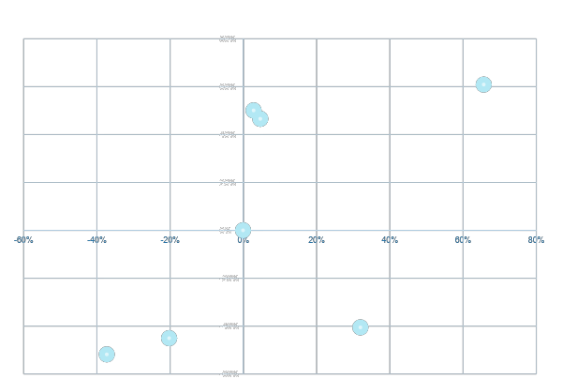
High Pressure
Note there is some correlation between intent and pressure and no farmers live in the low-intent high pressure segment (top left)
Visionaries or Leading Lights
Pressured Pragmatists
Note segment 3 looks like it overlaps Segment 5. The difference is that Segment 3 farmers perceive higher more significant barriers. Both segments are under some pressure to go digital, but they appear less open to implementation.
Segment 2 farmers are hungier for information and more open to new ideas and methods. They tend to be earlier adopters and are responsive to pressure.
Poised Pragmatists
Low Intent
High Intent
Note segment 1 looks like it nearly overlaps Segment 4. The difference is that Segment 1 farmers perceive higher more significant barriers. Segment 4 farmers are more disengaged.
Self Motivated Pragmatists
Unconsciously Conservative
Segment 6 have reasonably strong motivation but they are under less pressure than others to adopt digital solutions. They would respond to informative case studies (maybe from early adopter neighbours).
Consciously Conservative
Low Pressure

Slide 7
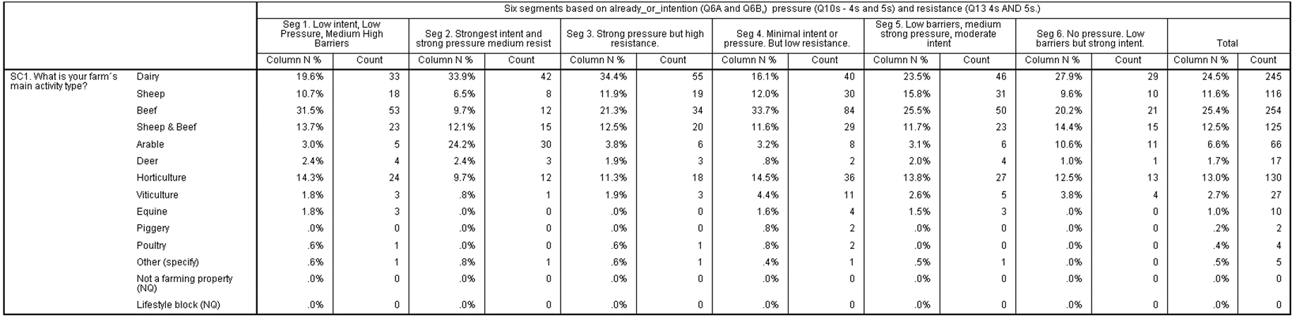
Consciously Conservative
Visionaries or
Leading Lights
Pressured Pragmatists
Unconsciously Conservative
Poised Pragmatists
Self Motivated Pragmatists

Slide 8
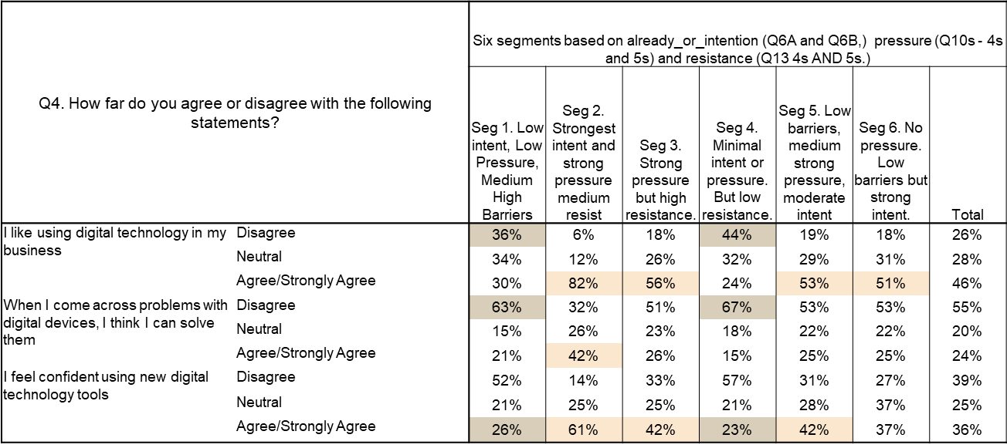
Consciously Conservative
Visionaries or
Leading Lights
Pressured Pragmatists
Poised Pragmatists
Unconsciously Conservative
Self Motivated Pragmatists

Slide 9
A majority of farmers believe tech adds real value to their operations
Farmers like tech, but need support
There are a range of business types that would require different types of support

